Slide 1
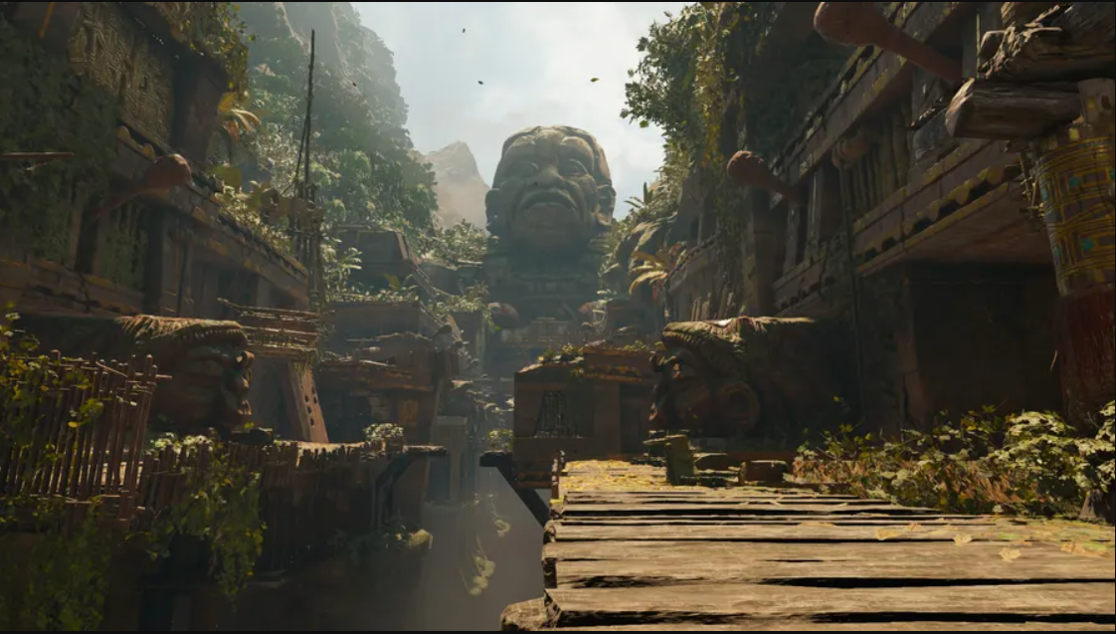
Data Visualization and Exploration

Slide 2
GGPLOT - Recap
http://www.sthda.com/english/wiki/ggplot2-essentials (good guide!)
ggplot is our plotting function; tells R to plot what we define in the rest of the code
data is our data frame
Aes is used to indicate aesthetics x and y variables. It can also be used to control the colour, the size or the shape of points, etc…..
Geom_ defines the type of graph we want to plot (box plot, dot plot, ...)
Extra layers such as labels, scales and themes are added to the main plot code by using + sign
ggplot(dataframe, aes(x =visit, y=mean_phago) + geom_boxplot()
Notes:
Now that our data is in good shape and all the variables are computed, we’re ready to try some plotting ☺
base r uses plot() function
Aesthetics is how you ‘map’ your data to the plotting space, so what are you going to use as x and y, what extra variable are you going to use to colour your graph by

Slide 3
GGPLOT – Colour Customisation
Colour plots by the factor of interest in your data frame:
ggplot(dataframe, aes(x=location, y=incidence, fill = Variable to colour data by)) + geom_boxplot() # Use color for line colors, fill for solid colors
Notes:
This is where it’s important to have recoded as factor, if variable was character ggplot would not be able to split the data up correctly fill or color

Slide 4
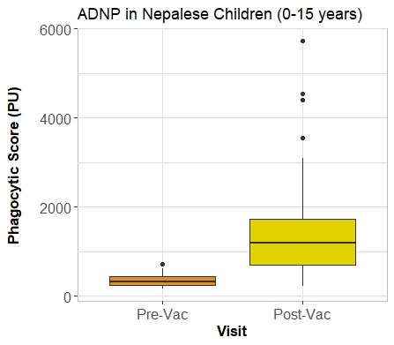
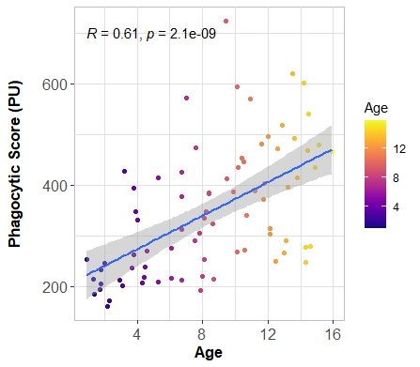
More Colours!
Colours can easily be added to plots from a variety of custom packages; Rcolorbrewer, viridis
+scale_fill_manual, +scale_fill_brewer + scale_fill_vidris
+scale_colour_manual, +scale_colour_brewer + scale_colour_viridis
+scale_color_gradient(), +scale_fill_gradient()
Notes:
Fill for whole objects, color for line or points

Slide 5
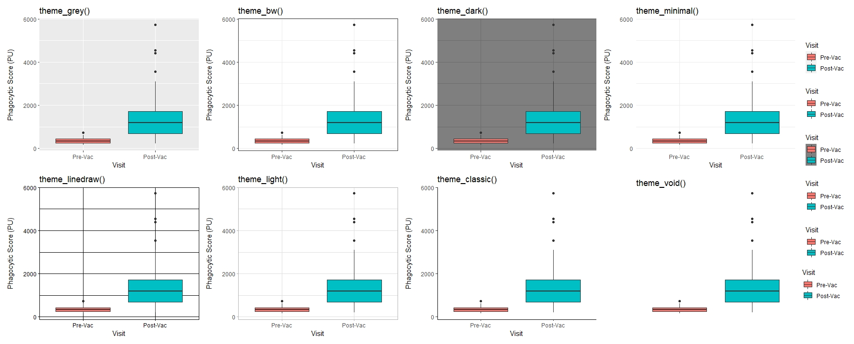
Themes
Provide quick and easy ways to clean your plot appearance
You can also create custom themes, removing legends, axis, text size, setting background colours etc.
Notes:
Highly recommend setting a theme once you’re happy with a plot’s appearance, and using it to keep graphs consistent

Slide 6
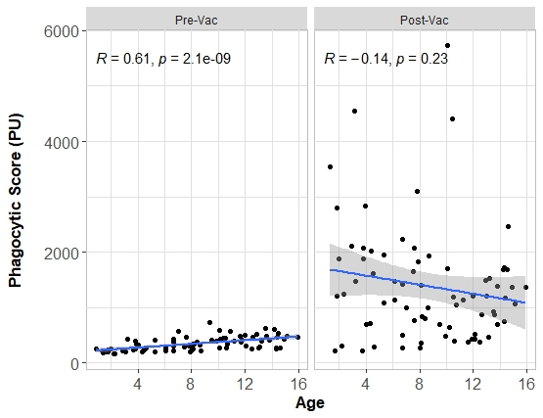
Faceting
Facet layer splits the plotting of your data by a factor variable
+facet_wrap(~Variable to split by)
+facet_wrap(Var1~Var2)
Notes:
Factor/categorical

Slide 7
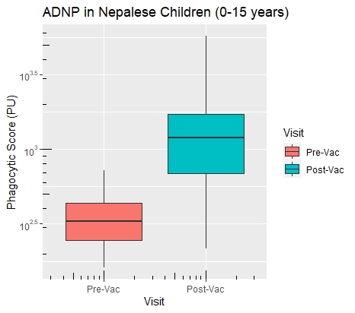
Axis Customisation
To change axis scales: load scales package
+ yscale("log10", “log2” .format = TRUE)
Or + scale_y_log10()
Add axis ticks using + annotation_logticks()
To modify axis limits use: +ylim() + xlim()
Notes:
Format option decides if we want to code files

Slide 8

Explore in R

Slide 9
GGPUBR
GGPLOT Wrapper (very similar syntax)
Makes plotting publication quality graphs easier with little formatting
Particularly good for box plots and adding statistical significance
ggplot(dataframe, aes(x= visit, y= mean_phago, fill = Variable to colour data by)) + geom_boxplot() + extra layers/customisation
ggboxplot(dataframe, x= visit, y= mean_phago, fill = Variable to colour data by, extra customisations)
Notes:
https://mode.com/blog/r-ggplot-extension-packages/
- Ggplot has x and y separate aes argument, type of plot and extra customisation other than color is done by the + sign
- GGPUBR specify type of plot beforehand, has preset customisations/options that you can do all within one function
I tend to use a mix! Recommend getting to know ggplot (helps you learn code), but also start to include ggpubr, eventually you may switch most of your plotting to it.
Again try save a separate script of plot code, that way you can reuse it when you want to make a similar type of graph but different data set again

Slide 10
Adding statistical significance to plots
http://www.sthda.com/english/wiki/comparing-means-in-r
I use the +stat_compare_means function
Define your comparisons beforehand, then + to plot ☺
Notes:
If it takes too long powerpoint your significance, check the resolution of your plots when exporting
Rstatix package more manual comparisons

Slide 11
Explore in R

Slide 12
Data Exploration and Loops

Slide 13
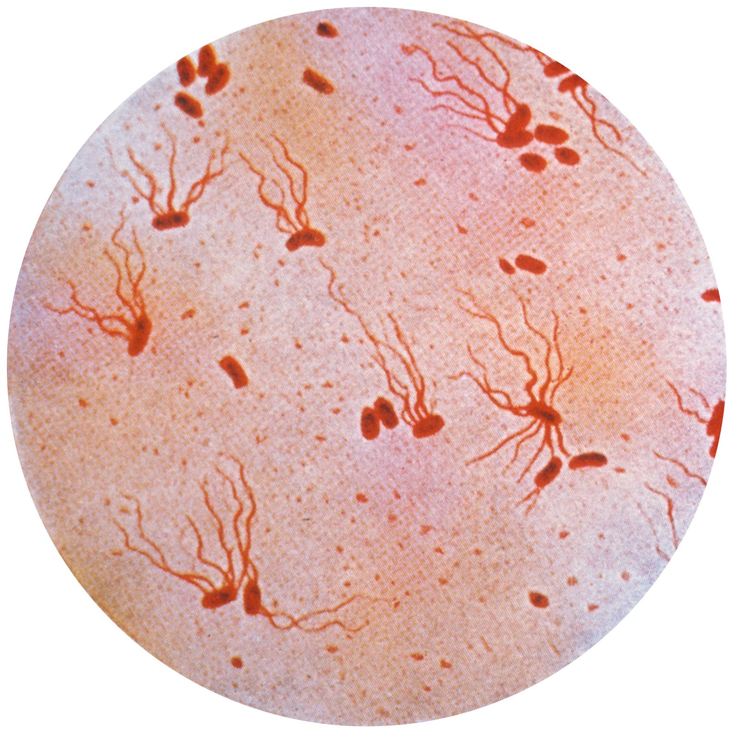
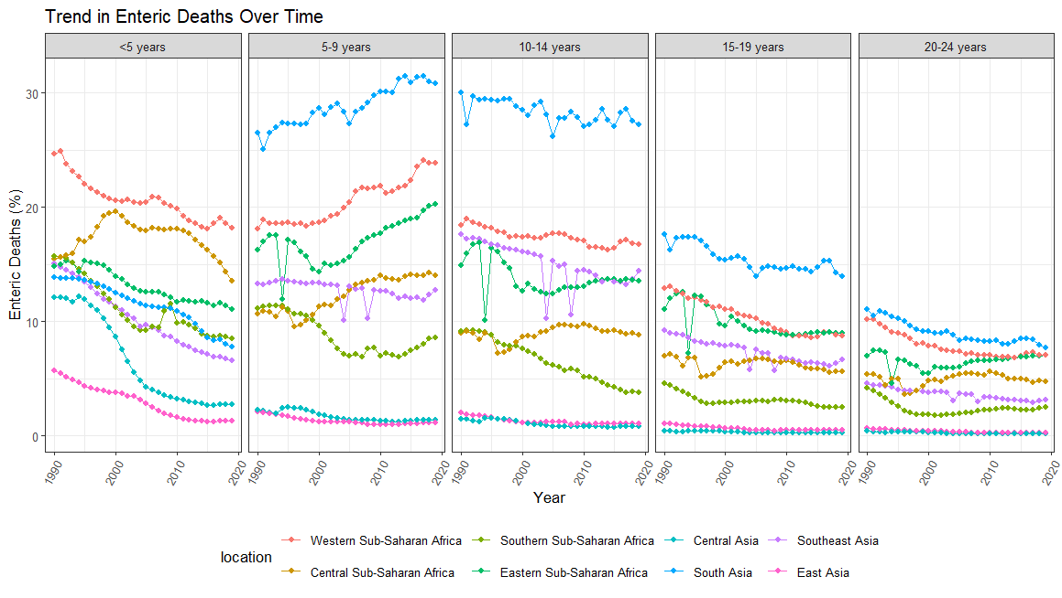
Recap
Notes:
GGPLOT, GGPUBR to visualize our data
On the y axis we have the for each location, the percentage of deaths in that region which are caused by enteric infections (i.e stomach infections- typhoid, cholera, rotavirus…)
X axis is the year- 1990-2020, and we have split our data by age groups, as well as region which is color coded
In the 5-9 year old group the percentage of deaths which are caused by enteric infections are rising… Now is that just because other causes are decreasing (%) makes it relative- or is the total number actually increasing…. We can get that data from the GBD site

Slide 14
Joining data
left_join(original_df, extra_df, by = c(“Joining var 1", "Joining var 2”))
Function | Objective
left_join() | Merge two datasets. Keep all observations from the original table
inner_join() | Merge two datasets. Excludes all unmatched rows
right_join() | Merge two datasets. Keep all observations from the extra table
full_join() | Merge two datasets. Keeps all observations
Original df, A, X
Extra df, B or Y
Notes:
Can join by one key/ID variable or more than one e.g AMPLE_ID and Visit
Left join filters out any extra data that we don't have in our orginal dataset, generally useful if you have collected more information/meta data on your samples, but your only intrested in getting information for this subset of participants you did an experiment on
Right join does the oposite, data that doesn’t have a match in your origina table is excluded and all data from the joining/extra table is kept
Inner_join excludes all unmatched rows
Full join keeps everything

Slide 15
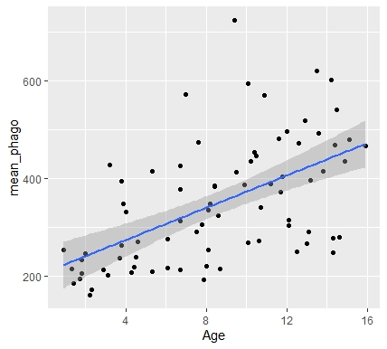
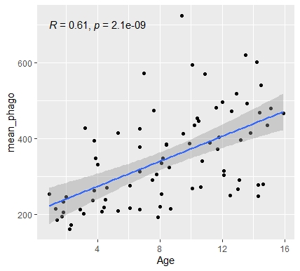
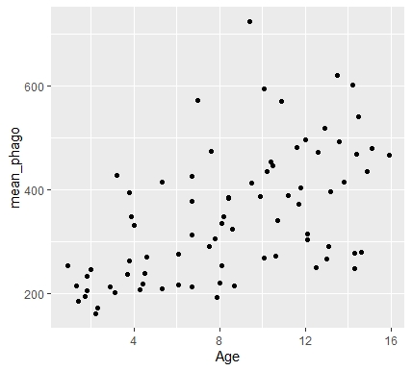
Correlation Plots
ggplot(dataframe, aes(x= Age, y= mean_phago)) + geom_point() + geom_smooth() + stat_cor(method = "pearson")
Plot a scatter graph of data using + geom_point()
Fit a regression line to our data using + geom_smooth(method = lm)
Add regression stats using + stat_cor(method = "pearson") – from ggpubr package
Notes:
Method=lm, SE around mean,
Highlight layer approach
More details at :http://www.sthda.com/english/wiki/ggplot2-scatter-plots-quick-start-guide-r-software-and-data-visualization

Slide 16
Explore in R

Slide 17

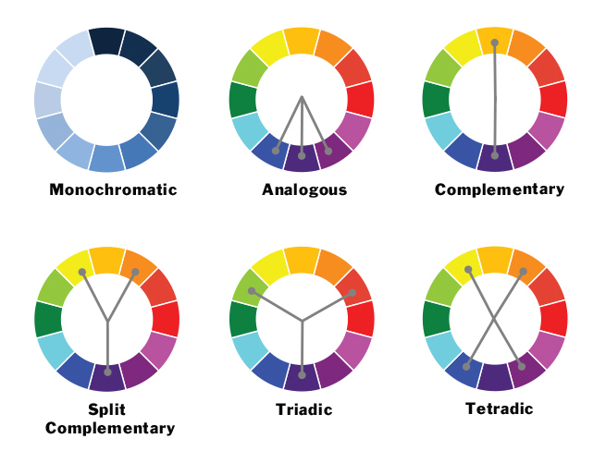
More Colours!
R colours can include anything specified by hex code
Any colour choice is possible - colortools package
Consider the rules of colour theory when plotting your data
contrasting results use complimentary, or triadic colours
Variations of a result i.e repeat observations use similar shades/schemes
Consider colour blindness – especially if colour is being used as the primary way for distinguishing data
http://colorschemedesigner.com/csd-3.5/ colour blind simulator

